Slide 1

New member
Orientation
2022/2023
M & M Team
Notes:
This is a great way for you to let new members and old ones know all about your club, the District and Kiwanis International. The power point is one that you can tweak to fit your own club. It has a place to add your own officers and tell about your club’s service projects.

Slide 2
New member orientation
Topics we will cover today:
Who we are
The Kiwanis Club of NAME
Kiwanis International
Texas Oklahoma District
Questions and wrap up
Notes:
We are going to be describing the club experience. Each club however has different ways of doing business. Get to know your club by attending board meetings and asking questions. We also want you to learn about the District by attending our conventions!

Slide 3
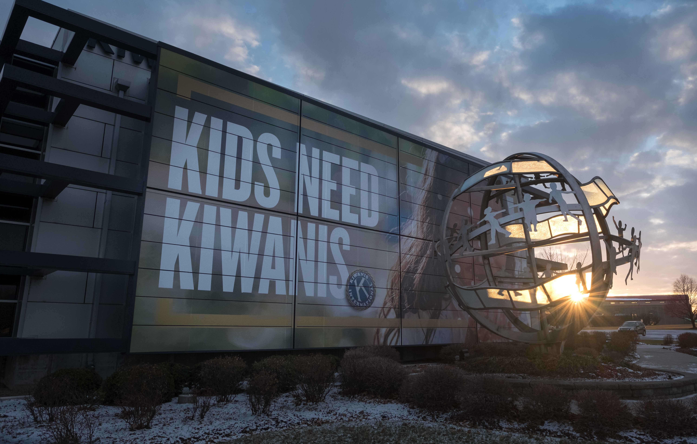
Welcome to Kiwanis!
Notes:
We are excited that you have joined Kiwanis. We want to tell you a bit about this great service organization and how you can get involved.
We want to ensure your experience is valuable.

Slide 4
Who we are
Defining statement
Kiwanis is a global organization
of volunteers dedicated to improving the world
one child and one community at a time.
Notes:
The defining statement of Kiwanis International offers a quick and thorough answer to the question “What is Kiwanis?”
The more the community understands Kiwanis, the more they will want to join us. The more members we have, the more hands to be of service, thus the greater our impact in our community.

Slide 5
International Leaders
Officers Serve Oct. 1 – Sept. 30
President: Bert West, Colorado District
President Designate: Katrina Baranko, Georgia District
Vice President: Lee Kuan Yong, Malaysia
Notes:
This is our current slate of officers for KI.

Slide 6
Who we are
Our motto: Serving the children of the world
What do we do?
Each year, Kiwanis clubs around the world:
Sponsor nearly 150,000 service projects
Devote more than 18.5 million hours to service
Raise more than US$100 million
Notes:
Our motto says it all….we are here to serve the children of the world. Our clubs do this by working in communities to better the lives of children through service projects and fundraising. Each year, our clubs sponsor nearly 150,000 service projects, devoting more than eighteen and half million hours to service. Our members also are fundraising to support those projects. We raise more than 100 million US dollars every year to fund our projects. So as you can see, our members adopt our motto and live it in their daily lives.

Slide 7
Who we are
Why are we here?
To improve lives through fellowship in service worldwide
Where are we?
More than 550,000 members from K-Kids to Key Club to Kiwanis in 80 nations and geographic areas
When did Kiwanis begin?
Founded in 1915 in Detroit, Michigan
Notes:
So, we are here to improve lives around us. And in doing so, we enjoy the fellowship of others in our community who are like-minded. But our community is not alone in this mission. While our club directly impacts our community, there are more than 7,000 clubs in 80 nations and territories. Together, our efforts are changing the world we live in. Kiwanis International has been doing this for more than 106 years and is more impactful than ever. We say kids need Kiwanis because Kiwanis is in the community to help meet the needs of children. Our clubs step in when county, city or school budgets are reduced and programs are cut. We help with book projects, food projects, playgrounds – everything a kid needs to be able to thrive, prosper and grow.

Slide 8
The Kiwanis Objects
To give primacy to the human and spiritual rather than to the material values of life.
To encourage the daily living of the Golden Rule in all human relationships.
To promote the adoption and the application of higher social, business and professional standards.
Notes:
The Kiwanis International Objects are our guiding principles. They were approved by Kiwanis club delegates at the 1924 convention in Denver, Colorado. They’ve inspired generations of Kiwanians—and they still hold true today.

Slide 9
The Kiwanis Objects
To develop, by precept and example, a more intelligent, aggressive and serviceable citizenship.
To provide, through Kiwanis clubs, a practical means to form enduring friendships, to render altruistic service and to build better communities.
To cooperate in creating and maintaining that sound public opinion and high idealism which make possible the increase of righteousness, justice, patriotism and goodwill.
Notes:
These objects are the driving force behind everything Kiwanis does. But it takes strong leadership to keep any group of people focused on the mission at hand. Kiwanis International supports a structure of leadership which helps clubs fulfill their primary purpose.

Slide 10
Kiwanis Children’s Fund
  Charitable entity of Kiwanis International
  Kiwanis cause areas:
    Education and Literacy
    SLP and Youth Leadership Development
    Health and Nutrition
    The Eliminate Project
    sustained elimination of iodine deficiency disorders
Notes:
The Kiwanis Children’s Fund solicits donations directly from our members.
With the Kiwanis Children’s Fund, every gift matters. In fact, your generosity helps children in many places, in many ways. The Children’s Fund has five areas of support: The Eliminate Project and the sustained elimination of iodine deficiency disorders are still important programs.
The Kiwanis Children’s Fund:
Supports the Kiwanis community on a global scale.
Provides the recognition and publicity for club contributions.
Provides money for matching scholarships to Key Clubs and Circle K clubs in your district.
Provides grants to clubs and districts to provide service to children.
Provides funds to support Kiwanis family programs at the International level.

Slide 11
Texas Oklahoma District
Notes:
Let’s take a look at this great District We call T-O Our District runs from the northern tip of Oklahoma down to Corpus. The only part of Texas not in our District is the El Paso area which his in the Southwest District

Slide 12




Kiwanis structure
Club
Division
Trustee
Kiwanis International
District
Notes:
This is how Kiwanis leadership is organized. It starts at the club level with our members. Our club belongs to a division with XX clubs and its own set of leaders, most notably a lieutenant governor who supports the clubs in the division. This individual is a key player in helping to ensure all clubs are on track.
The next layer of leadership is the T/O district is Trustee. We have 10 Trustees who are work together with the Governor to form our Board. This board is responsible for the Governance of the District. Our governor is elected yearly and leads both the Trustees and Lt. Governors. There are ___districts around the world. And, finally, we have Kiwanis International which houses all of the districts and provides support to all clubs through this structure.
As you can see, this multi-leveled leadership construction means our club is supported by a larger network of leaders who are prepared to help us be successful as we work to help our community.

Slide 13
District Structure
We are in Division _____
Our Lt. Governor is
_____________
We are in Region _____
Notes:
Your club is in a Division. Your Division head is called a Lt. Governor
Your Division is in a Region We have 10 regions in Texas Oklahoma Each region is run by a Trustee
The 10 Regions make up the Texas Oklahoma District

Slide 14

Texas Oklahoma District Foundation
Key Club Scholarships
CKI Scholarships
Sophomore of the Year
Women in Kiwanis
S

Slide 15
Leadership
Governor : __Patrick McCage
Governor-Elect: Dr. Kathy Culbertson
District Secretary: Al Richard
Marketing Director: Marshall Kregel
Administrative Supervisor: Laura Arnhart
S

Slide 16
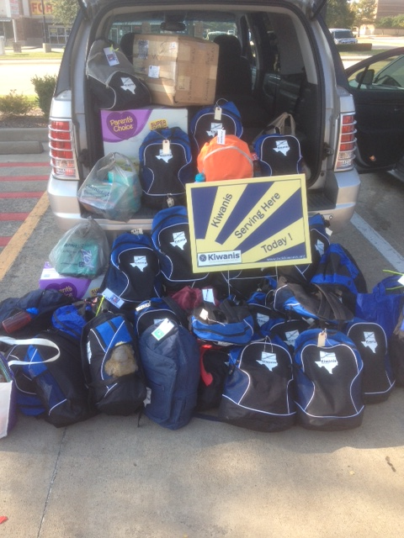
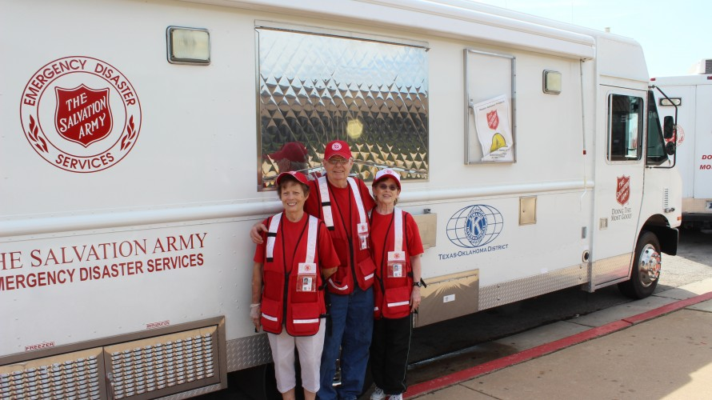
District Service Project
Disaster Relief
M
Notes:
Disaster Relief is our District’s main project. We are very proud of the hundreds of backpacks and funds we have donated.

Slide 17
Your
Club

Slide 18
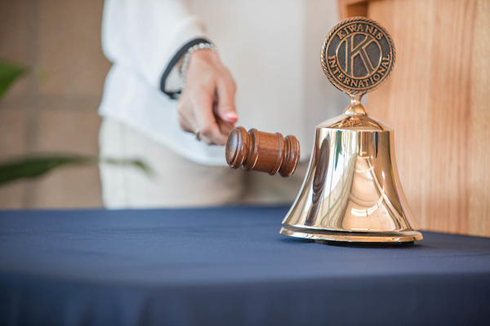
About your club
Kiwanis Club of NAME
Charter date:XXXXXX
Meeting day, time, and place
Notes:
Each Kiwanis Club is technically supposed to start out Kiwanis Club of _______________ but you will see many clubs list their city name first.
Charter Date is the date your club was recognized by Kiwanis International as being a club. T/O has club anywhere from 6 months old to over 100

Slide 19
Club Leaders
Officers Serve Oct. 1 – Sept. 30
President: ____________________
Vice President: ____________________
Secretary : _____________________
Treasurer: ______________________
Notes:
Fill in Officers before presenting. Club Officers also service from Oct. 1 – Sept 30

Slide 20
Quick glance at your club
Many clubs sponsor SLP or Sponsored Leadership Programs
Fundraisers
Service Projects
Participation in District and International Programs
Notes:
These are items most clubs participate in

Slide 21
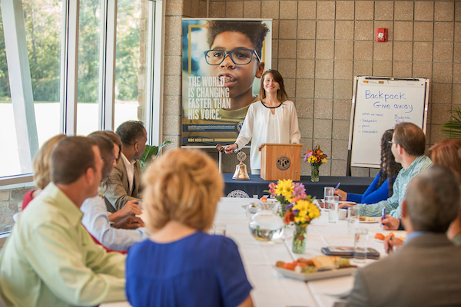
Your club’s committees
Financial review*
Membership
  Invitation/Retention
  Education
  Public relations
Programs
  Club meetings
  Special events
Service and fundraising
  Community services
  Service Leadership Programs
*This committee is required by the Kiwanis International Standard Form for Club Bylaws
Notes:
Committees provide opportunities for participation and leadership. Each club has a list of standing committees within their bylaws and policies, and many clubs have continued to add committees for different functions, such as specific fundraisers and service activities.
These are the standard committees listed in the Standard Form for Club Bylaws and policies. Larger clubs may have more committees to provide more opportunities for members to get involved; some small clubs combine or prioritize these committees. Focus on the work the club needs or wants to accomplish. Describe what each committee does. Club committees are where the work gets done and relationships are forged. Encourage new members to find a committee that interests them and to play a part.

Slide 22
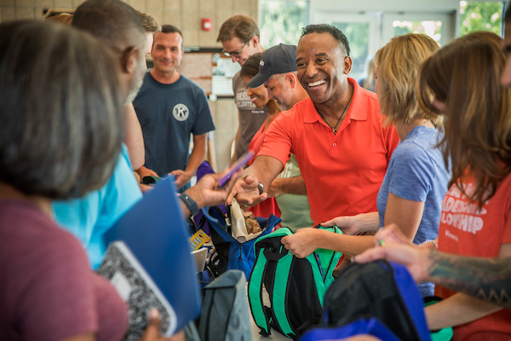
Your club’s service projects
Your Board should have
a list of those.
Pick and choose the
ones that interest you
Present an idea that
interests you!
M
Notes:
Relationships are forged by participating in the activities of the club.
It is important for new members to have an opportunity to participate in a service project right away.
Do you have an idea for a project?

Slide 23






Your club’s Service Leadership Programs
M
Notes:
Kiwanis International empowers people at every stage of life to become competent, capable and compassionate leaders by helping them learn to help others. Through its Service Leadership Programs, Kiwanis teaches students and adults ways to improve the world one child and one community at a time.
Our club sponsors SLP programs at these schools: ___________________________________________

Slide 24
Your club’s fundraising projects
Some Fundraisers are Yearly
Some Fundraisers are a one time event
Got An Idea?? Share it with your board!
Notes:
As with service projects and committee assignments, relationships are forged by participating in the activities of the club. You have probably all heard of the famous Kiwanis Pancake Days. Some clubs have a one time huge Fundraiser like the Wichita Falls Kiwanis that supports their club all year long while others such as the Bonham club have a market they support all year long.
You can add your own fund-raisers here!

Slide 25

Our club’s traditions
How You Open Meetings
How you retire your officers
How you honor those who
have served
Notes:
a typical club meeting may include club traditions such as Happy Dollars.
Some clubs start meetings with an invocation and singing, some don’t.
Be sure to evaluate your club’s traditions annually by asking your members if they meet their needs and expectations for their club.

Slide 26
Communication
  Newsletters
    KI Update;
    Texas Oklahoma Ki-Notes
    club, division and district
  Websites
    Club: Does your club have a website
    District: Txokkiwanis.org
    Kiwanis International: kiwanis.org
Notes:
Presenter notes: Describe each of these communication vehicles. Take time to show members the Kiwanis International website, kiwanis.org. Share the URLs for your club and district websites too.
Sharing information is critical to keeping members engaged. When you join a Kiwanis club, the club secretary will enter your information in our database. Within a month you should receive the first of a series of emails welcoming you to Kiwanis. You also will receive a mailed packet with information about Kiwanis.

Slide 27
Communication
  Kiwanis magazine: kiwanismagazine.org
  Social media
    Kiwanis International
      Facebook: facebook.com/Kiwanis
      Twitter: @Kiwanis
      Instagram: @Kiwanis
    District
    Facebook: facebook.com/texasoklahomakiwanis
    Club
      Does your club have a Facebook page?
Notes:
Presenter notes: Describe each of these communication vehicles. Take time to show members the Kiwanis International website, kiwanis.org. Share the URLs for your club and district websites too.
Sharing information is critical to keeping members engaged. When you join a Kiwanis club, the club secretary will enter your information in our database. Within a month you should receive the first of a series of emails welcoming you to Kiwanis. You also will receive a mailed packet with information about Kiwanis.

Slide 28

About Your club
Club leaders
President:
Immediate past president:
President-elect or vice-president:
Secretary:
Treasurer:
S
Notes:
officers change with each administrative year, which begins October 1.
Describe the election process for club directors and officers.
Explain what the annual club meeting is.
Share the date of the club’s next annual club meeting which is likely in April or May.
Encourage new members to consider running for office.

Slide 29
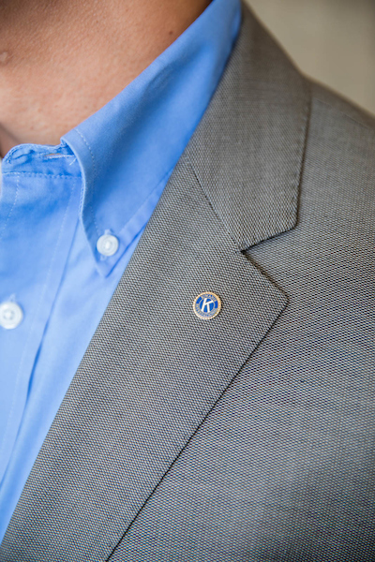
Club business
Members vote to:
  Elect club officers and directors
  Amend club bylaws
Board of directors:
  Determines club policies
  Approves club projects
  Approves and controls club’s budget
  Approves membership applications
  Manages the club
S
Notes:
Briefly explain the structure of voting and the responsibilities of the board of directors for your club.

Slide 30
Board of directors meeting
  Meeting are usually once a month
  All members are welcome to attend
  Only board members can vote
S
Notes:
Explain that all members are welcome to attend board meetings, but only board members and officers may vote.

Slide 31
Finance & budget
Administrative account
  Income from club dues, meal charges, new member fees
  For administrative expenses of club
Service account
  Income from public fundraising projects or contributions
  Cannot be used to pay club administrative expenses of the club
  Some Clubs also have a Foundation or 501©3
M
Notes:
In the United States, Kiwanis clubs are classified as 501(c)4 organizations therefore, dues and donations are not tax deductible.
Some clubs have 501(c)3 foundations that can accept tax deductible contributions. If your club has a 501©3 it MUST have a separate tax number and be kept separate from the service account.

Slide 32
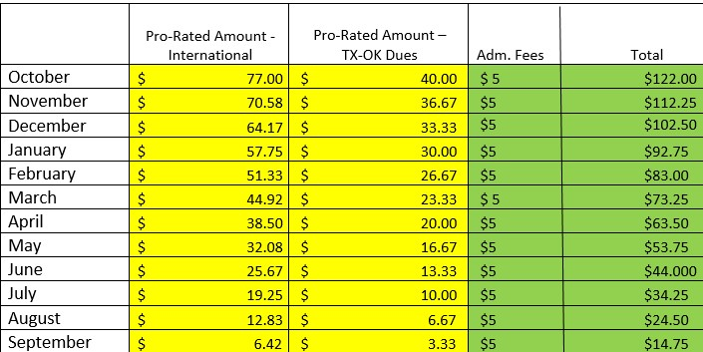
Dues
For 2022-2023
M
Notes:
These dues DO NOT include club dues. Dues for 2023-2024 Will follow the same structure

Slide 33

Become involved
  Attend club meetings
  Participate in service and fundraising projects
  Attend district council meetings
  Participate in inter-club meetings
  Serve on committees
  Run for office
  Spread the word about Kiwanis
S
Notes:
There are a number of ways to be involved with your club. We know you lead a busy life and understand that you are here to help in any way you can—we are grateful. Here is a list of common ways that members help our club.

Slide 34
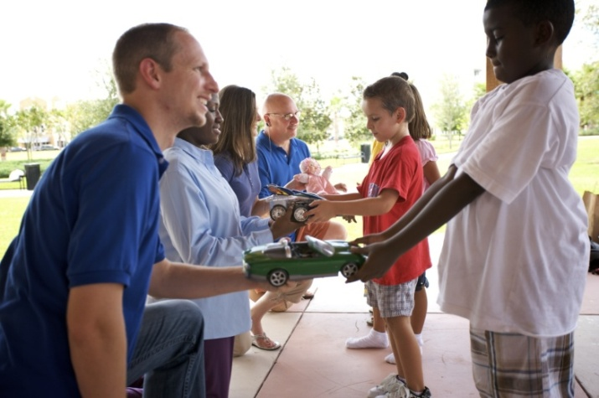
Benefits of membership
Change children’s lives
Improve your community
and the world
Build friendships
Enhance leadership skills
Networking
Notes:
We hope you get involved quickly in service projects. It is important that new members have an opportunity to participate in a service project right away. We want you to understand that feeling of pride and fulfillment that comes from being a part of an organization that makes a difference. This feeling of accomplishment is only one of the benefits of being a part of a local Kiwanis club
As a member of Kiwanis, you have the chance to change the lives of children all around the world. You will act locally in our community to improve the lives of area children, but our impact as an organization is felt worldwide. You will no doubt build new friendships through serving side-by-side with like-minded people. You will enhance your own leadership skills, and help develop leadership skills in the children we serve. You can also develop business contacts through your relationships in the club and the community. It is what we like to call a “win-win” situation, one where you benefit from being of service to others.

Slide 35
Kiwanis partners
  Kiwanis partners bring value to your club by providing services and products that enhance our service and
  work in the community.
  Kiwanis partners and resources: kiwanis.org/partners
M
Notes:
Kiwanis International believes in working collaboratively with businesses and organizations that share in our dedication to serving children. Here are some of our national partnerships: Landscape Structures Inc., for playground equipment; the Army; Scholastic Books; Nickelodeon, Boy Scouts, Children’s Miracle Network Hospitals – more information and a complete list is on the website at kiwanis.org/partners
Our partner’s products, services and reputation must:
Be compatible with and complementary to Kiwanis’ mission and values
Reflect a high degree of integrity
Demonstrate a track record of high-quality products or services
There is nothing that prevents your club from partnering with a local vendor or organization that has common values and is working with your clubs to meet the needs of children in your city or town.

Slide 36
Conventions
  District convention – August 4 - 6
  Kiwanis International convention
  Key Club International convention
  Circle K International convention
M
Notes:
Kiwanis International conducts an annual convention, which is held to:
Elect International Board members
Amend the International Bylaws
Provide Kiwanis fellowship
Provide Kiwanis education
Each club is allowed to have two delegates and two alternates. These delegates compose the House of Delegates and vote on the election of officers and new members to the Board of Trustees, resolutions, and proposed amendments to the Kiwanis International Bylaws. District conventions and conferences achieve the same objectives but at the district level. Some districts have regional meetings.
Our District Convention will be held this year in Georgetown, TX. We have all kinds of fun things planned YOU CAN TALK ABOUT SO<E OF THE EVENTS

Slide 37



QUESTIONS
M & M Marketing/Media Team
Who Do I
Ask???
2023/2024 Marketing Director
Marshall Kregel
2023/2024 Public Relations
Susan Hennum
Membership
New Club Building
Questions
2022/2023 Growth Chair
Brad McKenzie
BeKiwanis1@gmail.com
Questions for the
M & M Team
can be sent to
txokdistrict@gmail.com

